Slide 1
MAT 350 Engineering mathematics
Higher Order ODEs
UNDETERMINED COEFFICIENTS
Variation of parameters
Lecture:
Dr. M. Sahadet Hossain (Mth)
Professor
Department of Mathematics and Physics, NSU.

Slide 2





(1)
By dividing by the leading coefficient a₂(x)
(2)
In (2) we suppose that coefficient functions P(x), Q(x), and f(x) are continuous on some common interval I.
The complementary solution is.
(3)
We assume that the particular solution is of the same type-
y_{p}(x)

Slide 3






Substituting (3) and the foregoing derivatives into (2) and grouping terms yields
We also assume,

Slide 4





We now have our desired two equations for
and
(4)
(5)
(6)
(5).

Slide 5


Example-1:
Solution: The Auxiliary equation is
The complementary solution is.
we compute the Wornskian as
We identify,

Slide 6

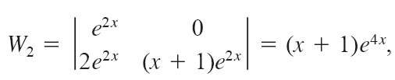


Then,

Slide 7


Hence, the particular solution is:
And, the general solution is

Slide 8

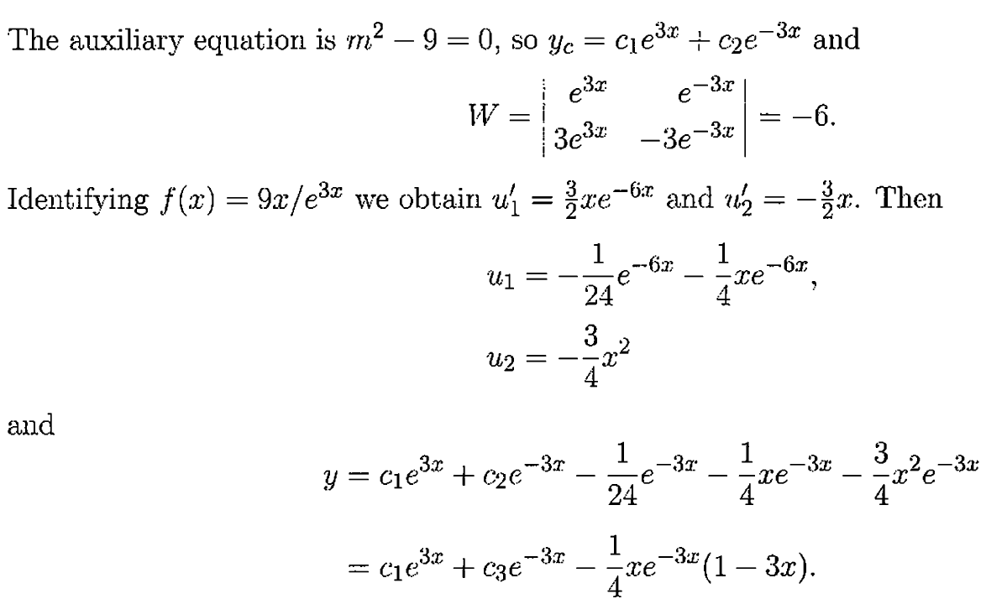
Exercise 4.6 ref. Zill

Slide 9

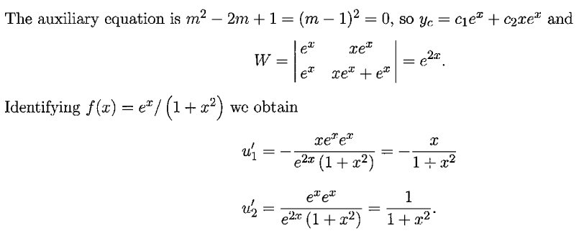



Slide 10





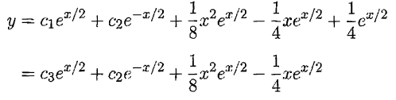
u

Slide 11

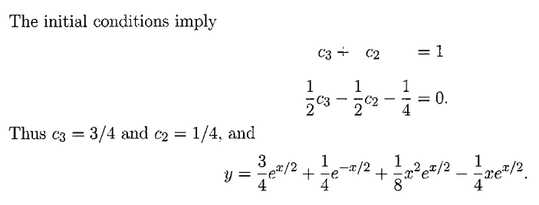

Slide 12





Solve each differential equation by variation
of parameters.
solve each differential equation by variation of parameters, subject to the initial conditions

